Slide 1



Design Patterns
Technology & Process for Growth
Design Patterns
Presenters
Madhu Babu Karanam

Slide 2
Design Patterns
A design patterns are well-proved solution for solving the specific problem/task.
Some of the benefits of using design patterns are:
Design patterns are already defined and provide an industry-standard approach to solving a recurring problem, so it saves time if we sensibly use the design pattern. There are many Java design patterns that we can use in our Java-based projects.
Using design patterns promotes reusability that leads to more robust and highly maintainable code. It helps in reducing the total cost of ownership (TCO) of the software product.
Since design patterns are already defined, it makes our code easy to understand and debug. It leads to faster development and new members of the team understand it easily.
Types
Creational
Structural
Behavioural

Slide 3
Design Patterns
Types
Creational : Creational design patterns provide solutions to instantiate an Object in the best possible way for specific situations.
Structural : Structural design patterns provide different ways to create a Class structure (for example, using inheritance and composition to create a large Object from small Objects).
Behavioural : Behavioral patterns provide a solution for better interaction between objects and how to provide loose-coupling and flexibility to extend easily.

Slide 4
Creational design patterns
Singleton – Ensures that at most only one instance of an object exists throughout application
Factory Method – Creates objects of several related classes without specifying the exact object to be created
Abstract Factory – Creates families of related dependent objects
Builder – Constructs complex objects using step-by-step approach
Prototype – Is used when the Object creation is costly and you have a similar Object already existing

Slide 5
Singleton pattern
Singleton pattern
The singleton pattern is a software design pattern that ensures only one instance of a class is created and shared throughout the application. This makes it a great pattern for resources that are shared across the entire system, such as caching, logging, thread pooling, configuration settings
Advantages
Reduced memory usage
Simplified access and control
Examples
Runtime class, Action Servlet, and Service Locator

Slide 6
Creational - Factory Method Pattern
Factory Method
When there is superclass and multiple subclasses and we want to get object of subclass based on input
Then we create factory class which takes responsibility of creating required object
Advantages
Focus on creating object for interface rather than implementation
Loose coupling, more robust code
Examples
Calendar, NumberFormat, and ResourceBundle

Slide 7
Abstract Factory Pattern
Abstract Factory
Abstract Factory is a creational design pattern that lets you produce families of related objects without specifying their concrete classes
Abstract Factory defines an interface for creating all distinct products but leaves the actual product creation to concrete factory classes.
Advantages
Focus on creating object for interface rather than implementation
Loose coupling, more robust code
Examples
javax.xml.parsers.DocumentBuilderFactory#newInstance()
javax.xml.transform.TransformerFactory#newInstance()
javax.xml.xpath.XPathFactory#newInstance()

Slide 8
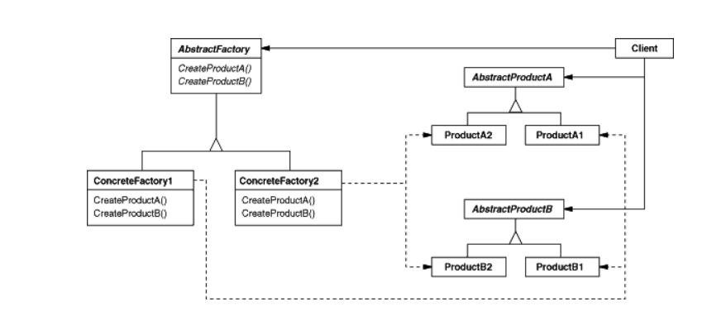
Abstract Factory Pattern

Slide 9
Structural design patterns
Adapter – It is used so that two unrelated interfaces can work together
Composite – Is used when we have to represent a part-whole hierarchy
Proxy – Provides a placeholder for another Object to control access to i
Flyweight – Can be applied to reduce the load on memory by sharing Objects
Facade – The facade pattern is used to help client applications easily interact with the system
Bridge – When we have interface hierarchies in both interfaces as well as implementations, then the bridge design pattern is used to decouple the interfaces from the implementation and to hide the implementation details from the client programs
Decorator : Is used to modify the functionality of an object at runtime

Slide 10
Structural Pattern
Adapter Pattern
Adapter design pattern is one of the structural design pattern and its used so that two unrelated interfaces can work together. The object that joins these unrelated interface is called an Adapter.
Advantages
Helps achieve reusability and flexibility.
Client class is not complicated by having to use a different interface and can use polymorphism to swap between different implementations of adapters

Slide 11
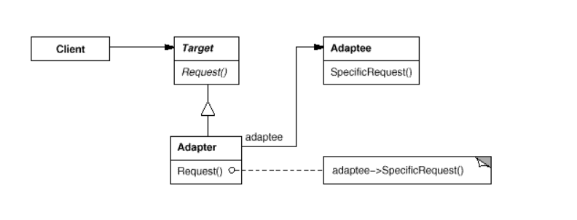
Adapter Pattern
The client makes a request to the adapter by calling a method on it using the target interface.
The adapter translates that request on the adaptee using the adaptee interface.
Client receive the results of the call and is unaware of adapter’s presence.

Slide 12
Structural Pattern
Decorator Pattern
The decorator pattern attaches additional responsibilities to an object dynamically. Decorators provide a flexible alternative to subclassing for extending functionality.
Decorator design patterns create decorator classes, which wrap the original class and supply additional functionality by keeping the class methods’ signature unchanged.
Advantages
Decorator design pattern is useful in providing runtime modification abilities and hence more flexible.
Its easy to maintain and extend when the amount of choices are more
Examples
FileReader reader = new FIleReader(new BufferedReader("abc.txt";
FileWriter writer = new FileWriter(new BufferedWriter("abc.txt");

Slide 13
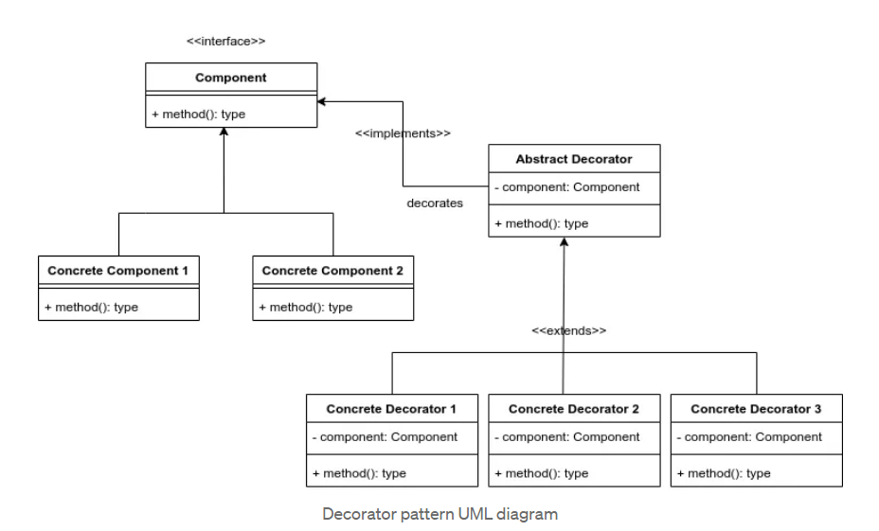
Decorator Pattern

Slide 14
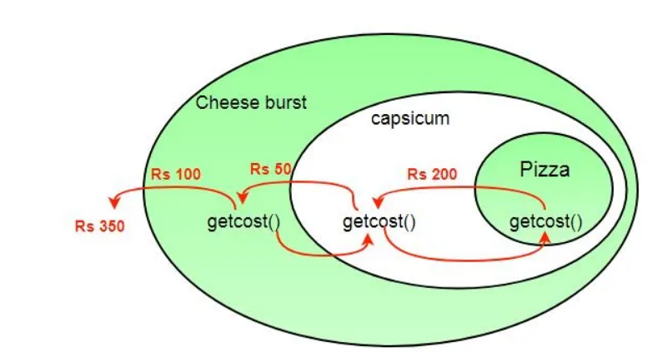
Decorator Pattern

Slide 15
Behavioral design patterns
Template Method – Is used to create a method stub and to defer some of the steps of implementation to the subclasses.
Mediator – Is used to provide a centralized communication medium between different objects in a system
Chain of responsibility – To achieve loose-coupling in software design where a request from the client is passed to a chain of objects to process them
Observer – Is useful when you are interested in the state of an Object and want to get notified whenever there is any change.
Strategy – Is used when we have multiple algorithms for a specific task, and the client decides the actual implementation be used at runtime
Command – Is used to implement loose-coupling in a request-response model
State : Is used when an Object changes its behavior based on its internal state
Visitor : Is used when we have to perform an operation on a group of similar kinds of objects.

Slide 16
Behavioral Patterns
Observer Pattern
Observer pattern is used when there is one-to-many relationship between objects such as if one object is modified, its depenedent objects are to be notified automatically
Advantages
It supports the principle of loose coupling between objects that interact with each other.
It allows sending data to other objects effectively without any change in the Subject or Observer classes.
Observers can be added/removed at any point in time.
Examples:
java.util.EventListener in Swing
javax.servlet.http.HttpSessionBindingListener
javax.servlet.http.HttpSessionAttributeListener

Slide 17
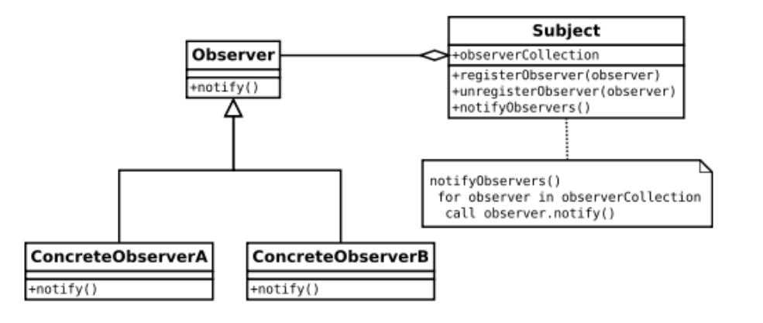
Behavioral Patterns

